Slide 1
Simplex Stop and wait Datalink Protocols

Slide 2
Simplex Protocols
An Unrestricted Simplex Protocol
A Simplex Stop-and-Wait Protocol
A Simplex Protocol for a Noisy Channel
Simplex means:
Data can flow in one direction only
Control packets can flow in both directions

Slide 3
Basic Assumptions
Assume network layer at endpoints want reliable connection-oriented channel
In order delivery: Packets are always delivered to network layer in order
No duplicate packets: Never deliver duplicate packets to the network layer
No packets are lost: Never skip delivering a packet to the network layer.
No errored packets: The payload delivered to the network layer of the receiver is identical to the payload sent by the network layer at the sender
No deadlock: Packets are delivered in a finite amount of time. E.g a packet never gets stuck at the sender or the receiver datalink layer

Slide 4
Frame Header
Frame kind/type
Sequence Number
Acknowledgement Number

Slide 5
Unrestricted Simplex Protocol
Assumptions:
Perfect world
1-Error free communication channel
2-Sender has infinite buffer
3-Receiver has infinite buffer
4-Receiver can process all input infinitely fast
5-Sender network layer has infinite packet supply to send
6-Propagation delay is negligible

Slide 6
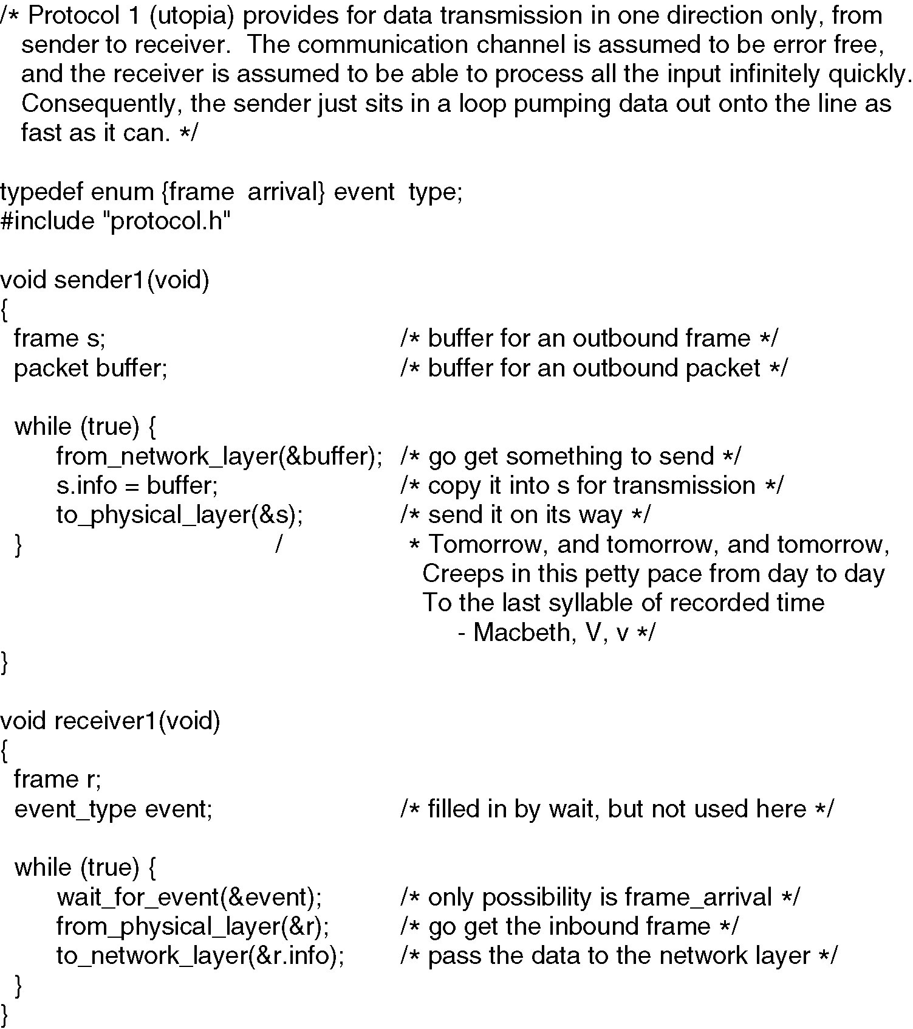

Slide 7
Simplex Stop-and-Wait Protocol
Assumptions:
Semi-perfect world
Drop the unrealistic assumption at the receiver
Receiver has finite buffer
Receiver has finite processing capacity
Error free channel
Sender has infinite buffer
Sender Network layer has infinite supply of packets to send
What and where error can occur?
Packet drop at the receiver side

Slide 8
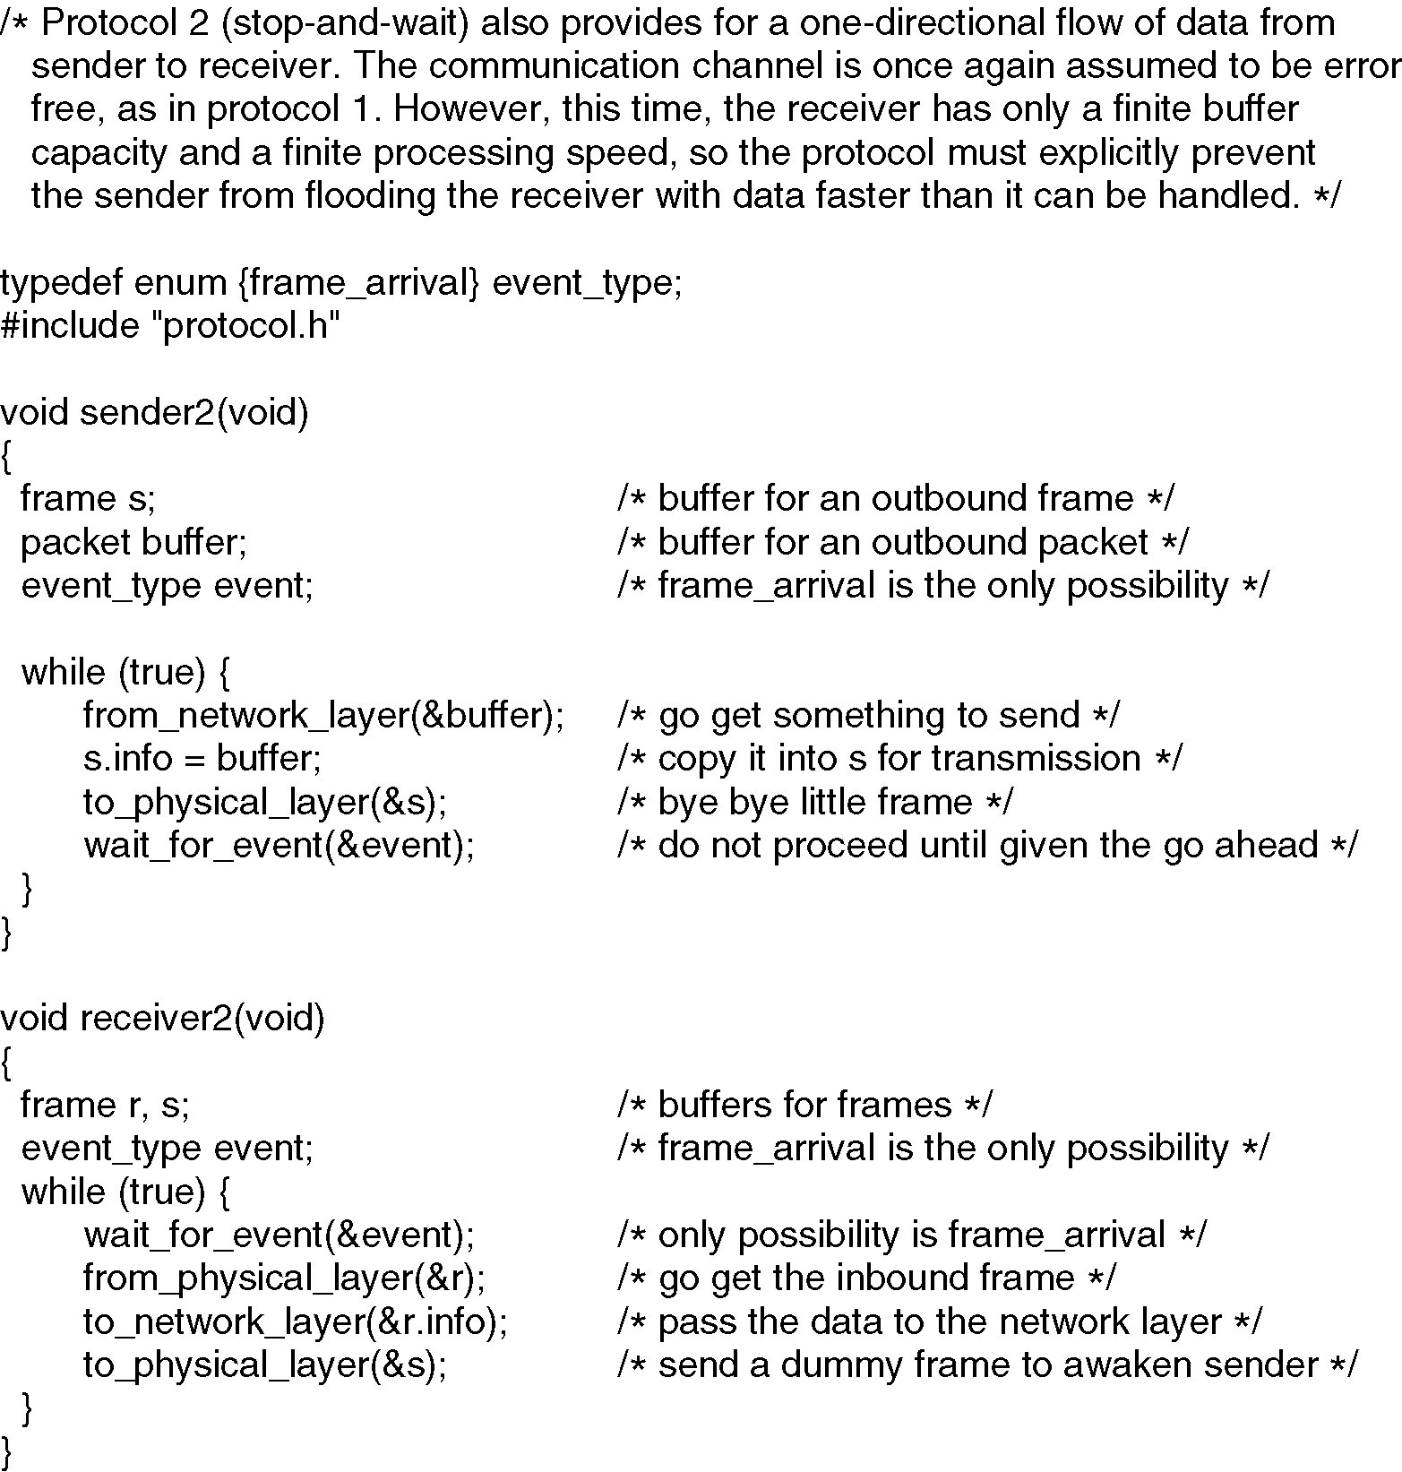

Slide 9
A Simplex Protocol for a Noisy Channel
Assumptions:
Assume possible frame damage or loss in both direction
Assume errored packets are detected correctly
Assume that the propagation delay is greater than zero
Use a timeout at the sender
Sender only transmits next frame if it received correct ACK (damaged ACK are discarded)
If it does not receive a correct ACK, it times-out and re-transmits the same frame

Slide 10
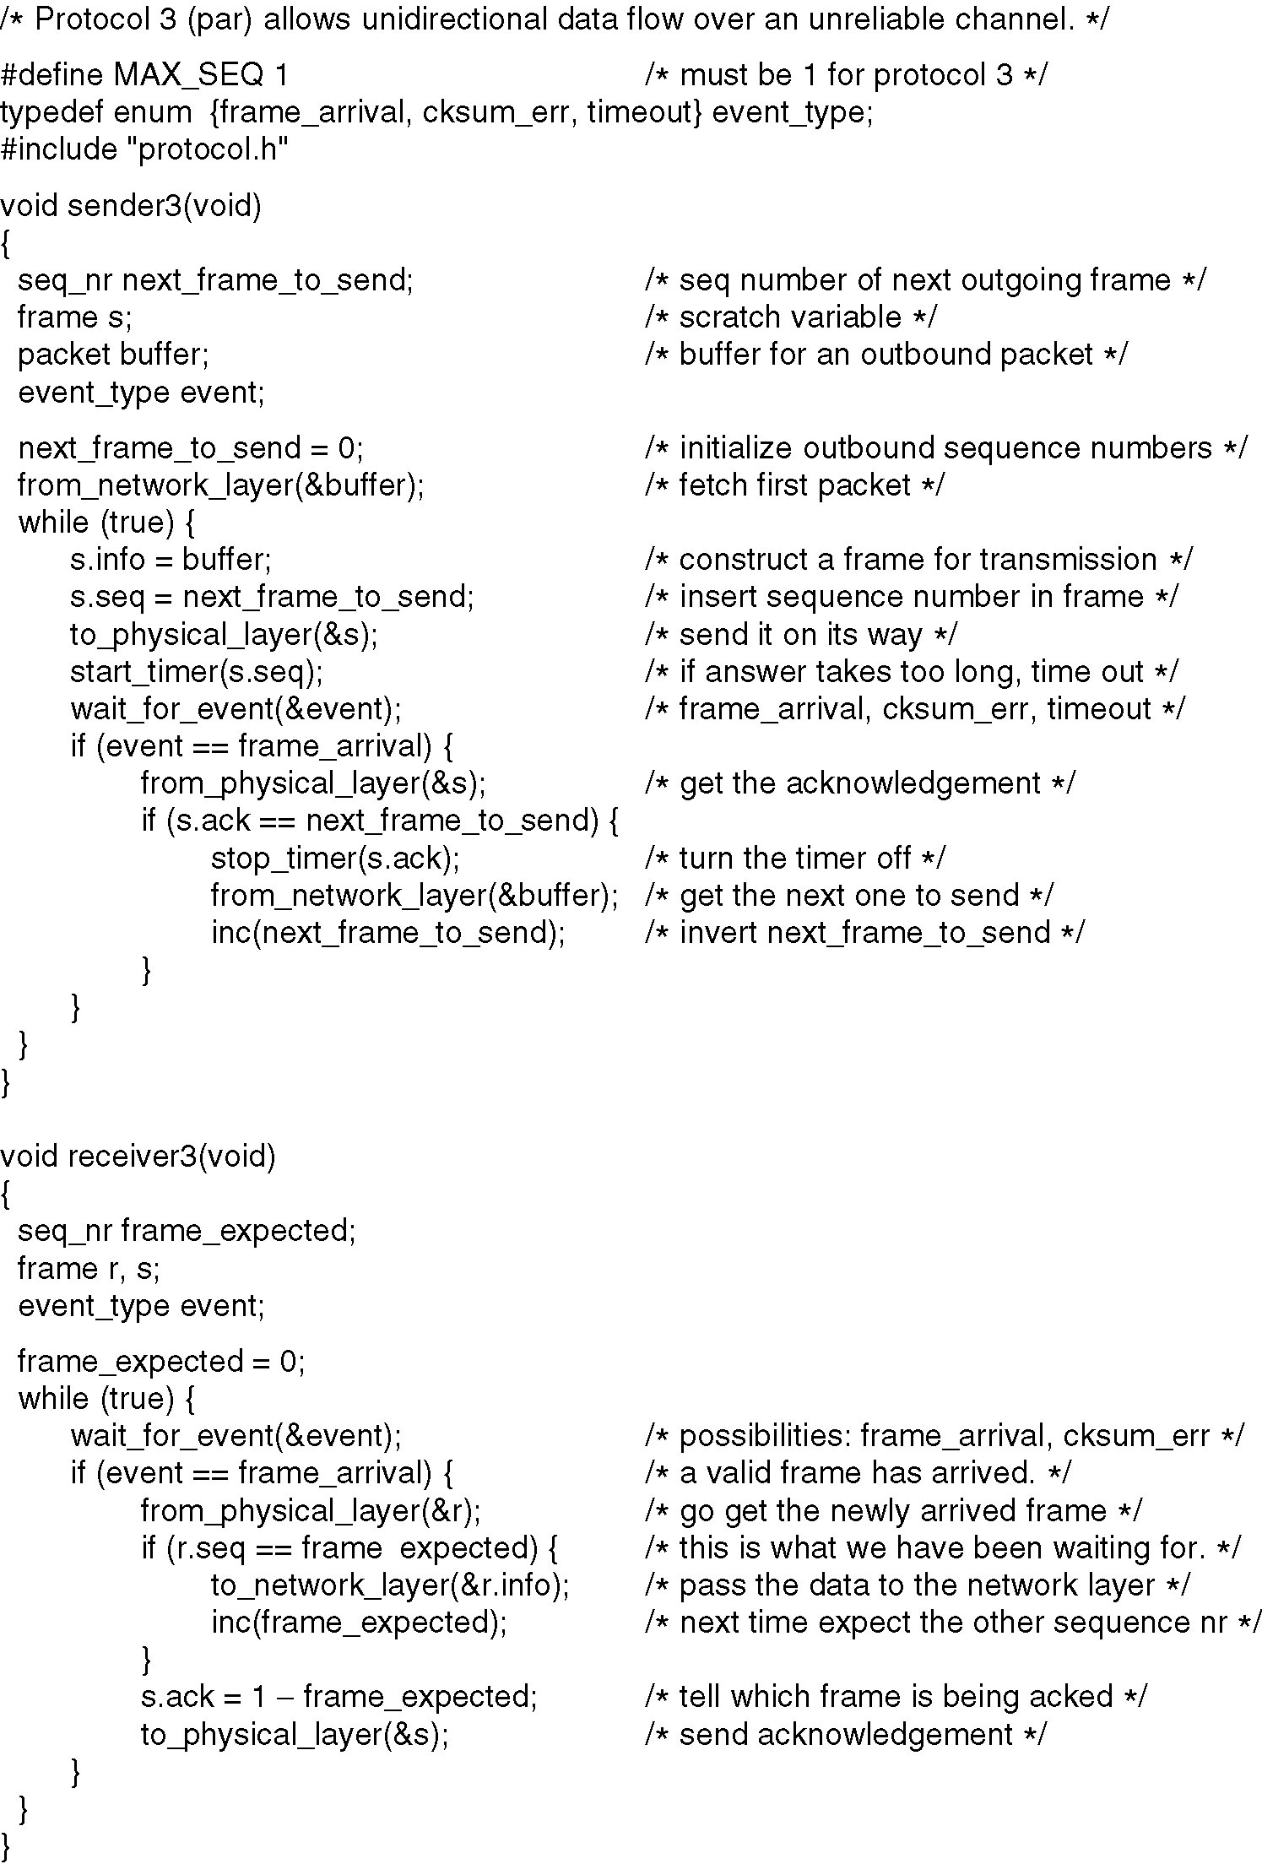
Assume that an errored frame generates the event “checksum_err”. We will ignore this event.
This is similar to assuming that physical layer discards errored packets
If (s.ack == 1- next_frame_to_send) {
stop timer(next_frame_to_send)
from_network_layer(&buffer)
Inc(next_frame_to_send)
}
Circular increment
Continued →

Slide 11
Assume that an errored frame generates the event “checksum_err”. We will ignore this event.
This is similar to assuming that physical layer discards errored packets
Receiver sends ACK for next expected frame
Receiver sends ACK every time it receives ANY packet

Slide 12
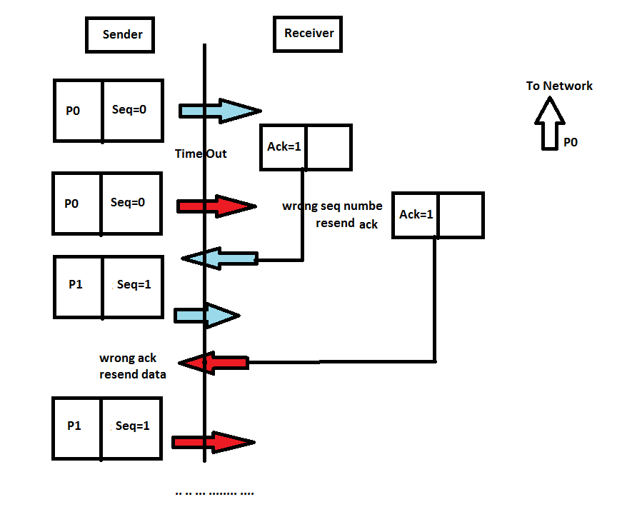
If time out> round trip time

